Slide 1
Chapter 5: Threads
Overview
Multithreading Models
Threading Issues
Pthreads
Solaris 2 Threads
Windows 2000 Threads
Linux Threads
Java Threads

Slide 2
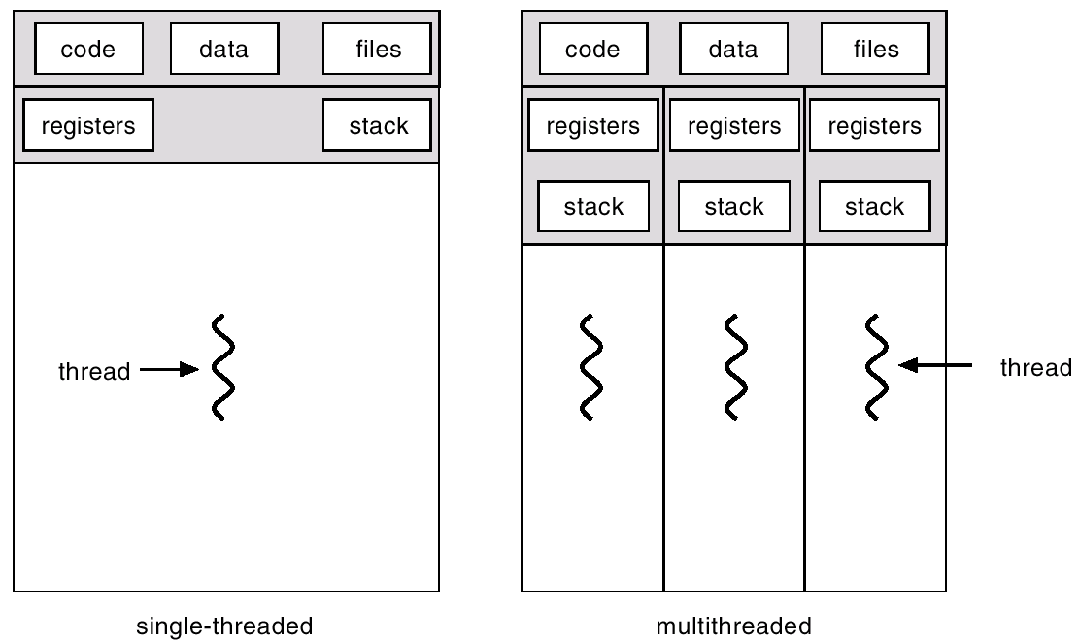
Single and Multithreaded Processes

Slide 3
Benefits
Responsiveness
Resource Sharing
Economy
Utilization of MP Architectures

Slide 4
User Threads
Thread management done by user-level threads library
Examples
- POSIX Pthreads
- Mach C-threads
- Solaris threads

Slide 5
Kernel Threads
Supported by the Kernel
Examples
- Windows 95/98/NT/2000
- Solaris
- Tru64 UNIX
- BeOS
- Linux

Slide 6
Multithreading Models
Many-to-One
One-to-One
Many-to-Many

Slide 7
Many-to-One
Many user-level threads mapped to single kernel thread.
Used on systems that do not support kernel threads.

Slide 8
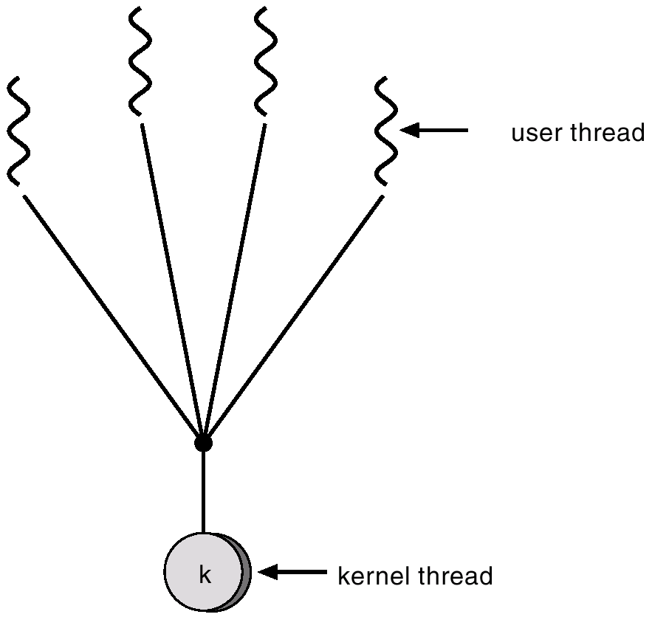
Many-to-One Model

Slide 9
One-to-One
Each user-level thread maps to kernel thread.
Examples
- Windows 95/98/NT/2000
- OS/2

Slide 10
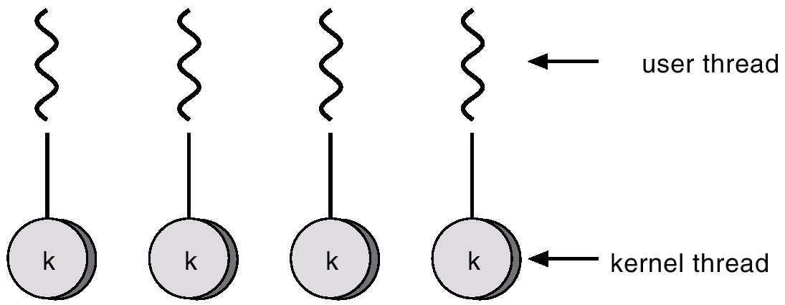
One-to-one Model

Slide 11
Many-to-Many Model
Allows many user level threads to be mapped to many kernel threads.
Allows the operating system to create a sufficient number of kernel threads.
Solaris 2
Windows NT/2000 with the ThreadFiber package

Slide 12
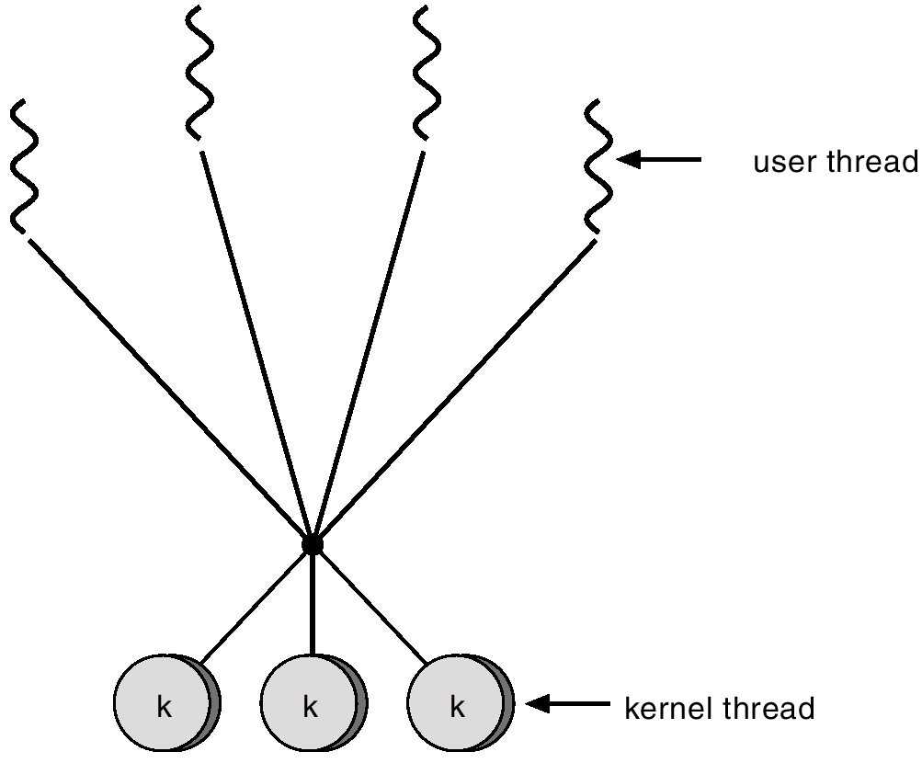
Many-to-Many Model

Slide 13
Threading Issues
Semantics of fork() and exec() system calls.
Thread cancellation.
Signal handling
Thread pools
Thread specific data

Slide 14
Pthreads
a POSIX standard (IEEE 1003.1c) API for thread creation and synchronization.
API specifies behavior of the thread library, implementation is up to development of the library.
Common in UNIX operating systems.

Slide 15
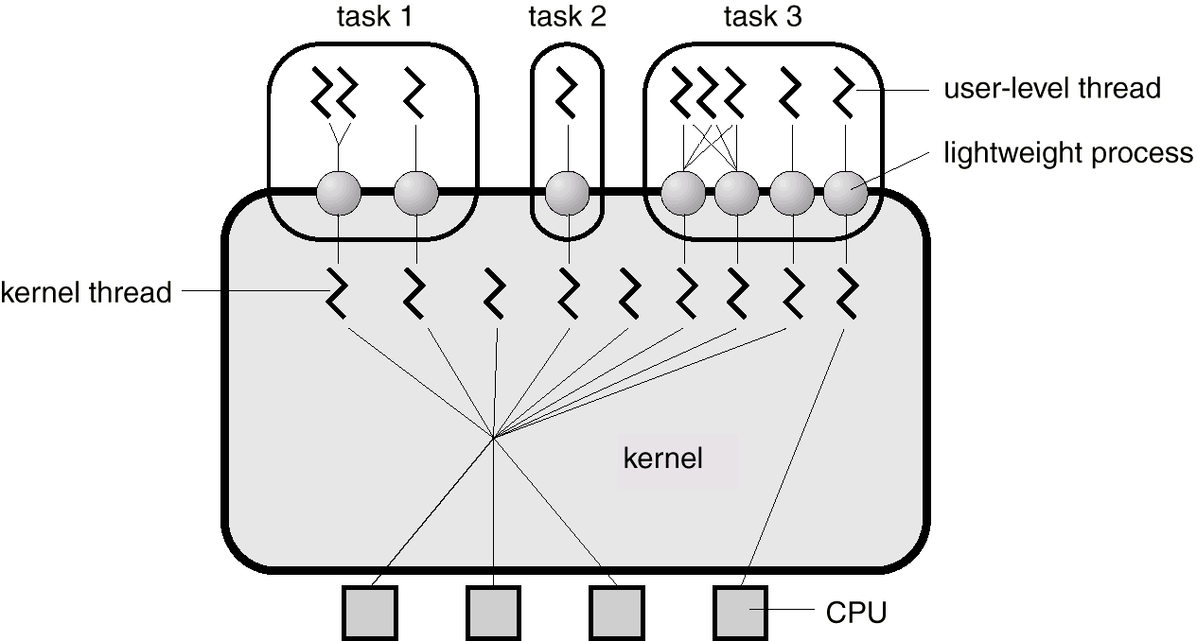
Solaris 2 Threads

Slide 16
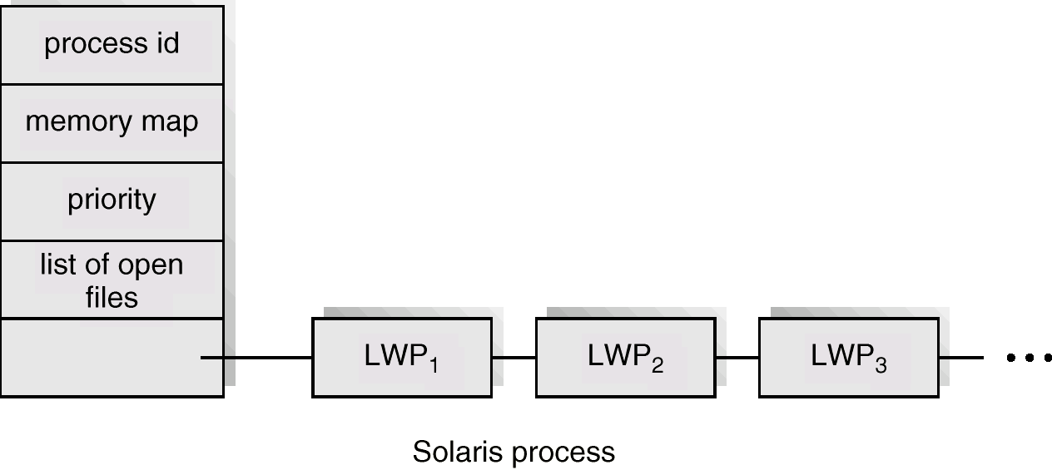
Solaris Process

Slide 17
Windows 2000 Threads
Implements the one-to-one mapping.
Each thread contains
- a thread id
- register set
- separate user and kernel stacks
- private data storage area

Slide 18
Linux Threads
Linux refers to them as tasks rather than threads.
Thread creation is done through clone() system call.
Clone() allows a child task to share the address space of the parent task (process)

Slide 19
Java Threads
Java threads may be created by:
  Extending Thread class
  Implementing the Runnable interface
Java threads are managed by the JVM.

Slide 20
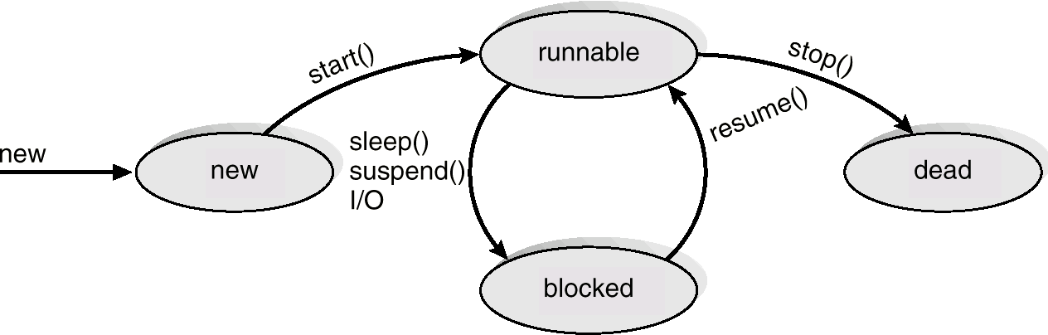
Java Thread States

